Slide 1


Import

Slide 2

“I use databases because its where the
data is.”
rob banks
money
–Willie Sutton

Slide 3
(Applied) Data Science
Visualize
Import
Tidy
Model
Communicate
Transform
Program

Slide 4


SQL

Slide 5
“SQL is a domain specific language used in programming and … data held in a relational database management system”
–Wikipedia

Slide 6

Structuring a Query

Slide 7
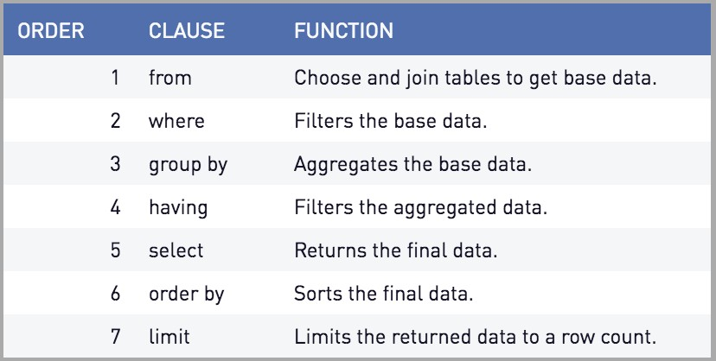
QUERIES
Source: periscope data

Slide 8


EXERCISE
Open DBeaver and connect to the Data Warehouse
Build a query that selects all of the air quality readings from the Health_AVData_AqiDailyMax table.
Hint 1: The Table is in the
Hint 2: The Data Warehouse is a Microsoft SQL database, so any web searches you do should be based off that syntax

Slide 9

SOLUTION
SELECT * FROM Master. Health_AVData_AqiDailyMax

Slide 10
WHERE

Slide 11
BETWEEN … AND
BETWEEN
Grab Values between two other values, like IN but for numeric values
Works like < and >
SELECT column_name(s) FROM table_name
WHERE column_name BETWEEN value1 AND value2;

Slide 12
IN STATEMENTS
Useful for when you have an input that returns multiple
This works the same way %in% does in R
Checks to see if the value in the column matches any of the values in your list
SELECT column_name(s) FROM table_name
WHERE column_name IN (value1, value2, ...)

Slide 13

EXERCISE
Open DBeaver and connect to the Data Warehouse
This time let’s target Dog Licenses (Treasurer_licenseAC_vw_DogLicenseSearchData)
Use the BETWEEN function as a WHERE filter to get dog licenses that expired in the years 2015 to 2018.
Stretch goal: Use the IN Filter to only get licenses for MIXED, WELSH CORGI CARDIGA and SHIBA INU Breeds.

Slide 14
SOLUTION
SELECT * FROM Master.Treasurer_licenseAC_vw_DogLicenseSearchData WHERE ExpYear BETWEEN 2015 AND 2018
SELECT * FROM Master.Treasurer_licenseAC_vw_DogLicenseSearchData
WHERE ExpYear BETWEEN 2015 AND 2018 AND
Breed IN ('MIXED', 'WELSH CORGI CARDIGA', 'SHIBA INU')

Slide 15
Pop Quiz
Tidyverse equivalent?
filter()

Slide 16
SELECT Functions and GROUP BY

Slide 17
SQL FUNCTIONS
Sometimes you don’t just want the raw data
‣
‣
You want to aggregate the data in SQL before you load it into R
Use another server to do the heavy lifting so you don’t have to!
This is where
‣

Slide 18
DISTINCT
DISTINCT()
Every unique value of a column.
Placing TWO columns inside will return unique instances of both columns:
DISTINCT(“REQUEST_TYPE”, “DEPARTMENT”)

Slide 19
Pop Quiz
Tidyverse equivalent?
distinct()

Slide 20
MATH FUNCTIONS
MIN()
Returns minimum value in a column(s)
MAX()
Return max value in a column(s)

Slide 21
Pop Quiz
Tidyverse equivalent?
min(), max()

Slide 22
COUNT, AVERAGE, SUM
COUNT() - returns the number of rows that your query returns
SELECT COUNT(column_name) FROM table_name
AVG() - returns the average value of a numeric column.
SELECT AVG(column_name) FROM table_name
SUM() - function returns the total sum - numeric columns only
SELECT SUM(column_name) FROM table_name

Slide 23
Pop Quiz
R/Tidyverse equivalents?
n(), mean(), sum()

Slide 24
GROUP BY
This is helpful for when you are doing any of the summary functions mentioned in the previous slides.
(COUNT, SUM, MAX etc)
Any column that isn’t handled with a function should be included in your GROUP BY
SELECT column_name(s), max(column_name) FROM table_name
WHERE condition
GROUP BY column_name(s)

Slide 25
Pop Quiz
Tidyverse equivalent?
group_by()

Slide 26
EXERCISE
Open Dbeaver and connect to the Data Warehouse
Build a query that gives the Max number AQI for each Air Quality Site and Parameter
Hint: Group by SiteName and ResponsibleParameterName
Stretch Goal: Give each year’s max
Hint: Look up documentation for the DATEPART() SQL Server function
‣

Slide 27
SOLUTION
SELECT MAX(AirQualityIndex) MaxAqi,
SiteName,
ResponsibleParameterName
FROM Master.Health_AVData_AqiDailyMax
GROUP BY SiteName,
ResponsibleParameterName
SELECT MAX(AirQualityIndex) MaxAqi,
DATEPART(year, AqiDate) Year,
SiteName,
ResponsibleParameterName
FROM Master.Health_AVData_AqiDailyMax
GROUP BY SiteName,
ResponsibleParameterName,
DATEPART(year, AqiDate)

Slide 28
Other Functions

Slide 29
CASE
CASE statements are for when you want to return categorical values based off of something else.
SELECT OrderID, Quantity, CASE WHEN Quantity > 30 THEN "The quantity is greater than 30" WHEN Quantity = 30 THEN "The quantity is 30" ELSE "The quantity is under 30" END AS QuantityText FROM OrderDetails;

Slide 30
Pop Quiz
Tidyverse equivalent?
case_when()

Slide 31
CONCAT
CONCAT()
This is mostly used when you have multiple columns you need.
May look different depending on DB server
SELECT CONCAT(column1, " ", column2) AS ConcatenatedString;
OR
SELECT column1|| " “ || column2 AS ConcatenatedString;

Slide 32
Pop Quiz
R equivalent?
paste()/paste0()

Slide 33
JOINS

Slide 34
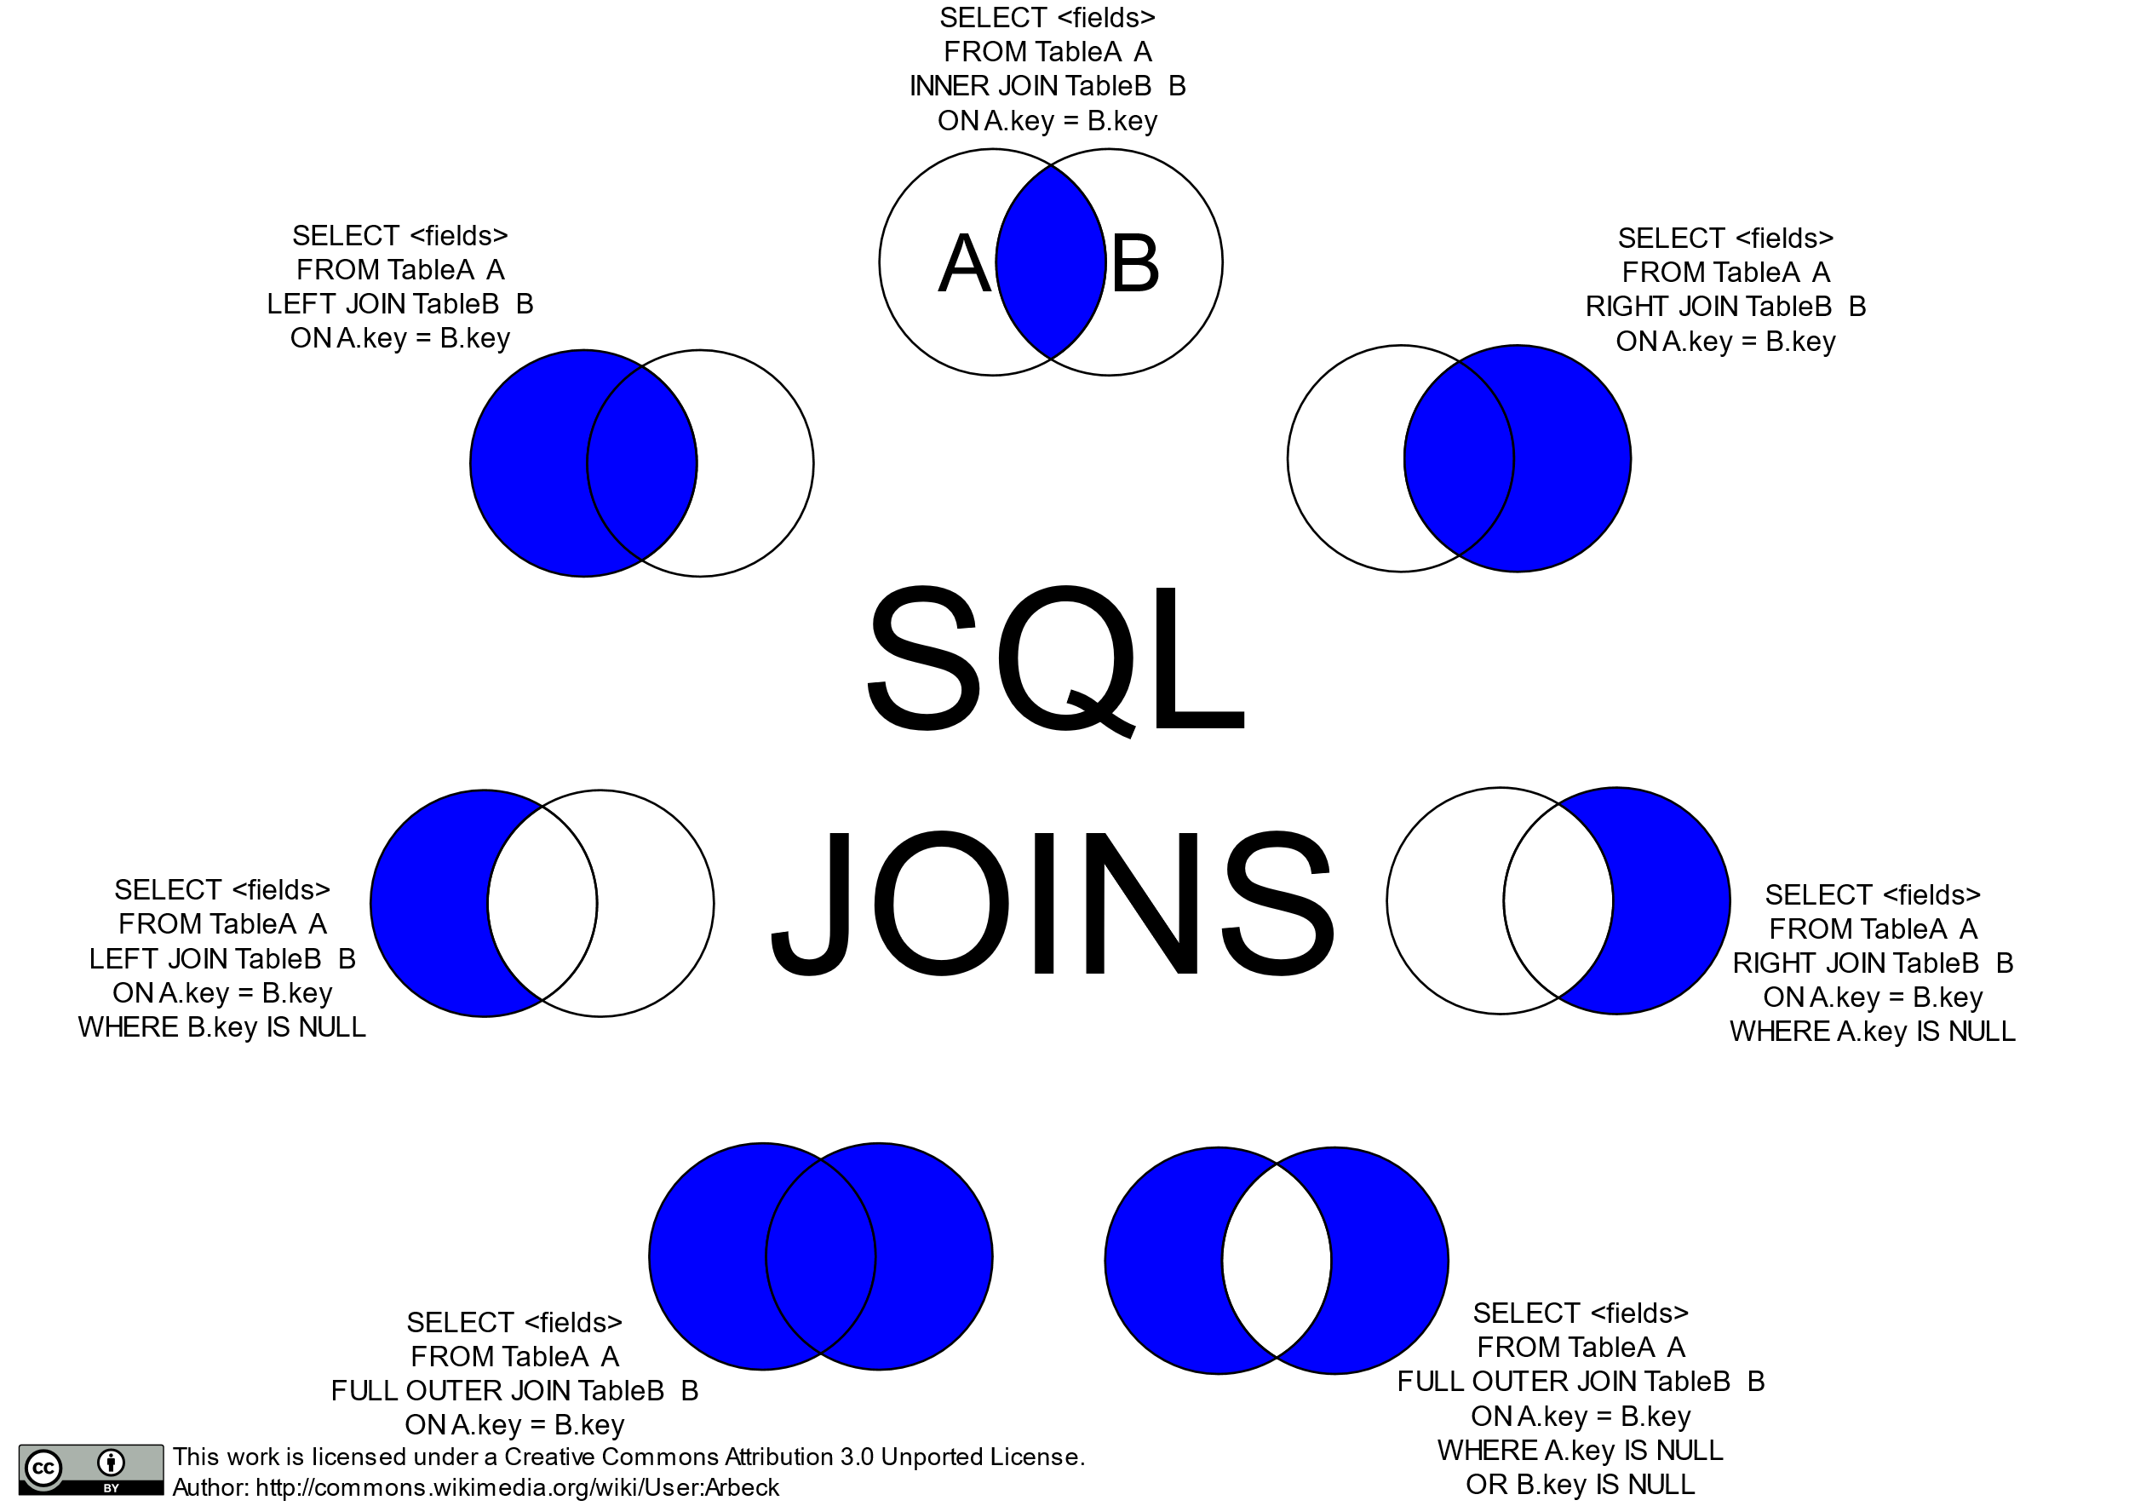

Slide 35
Left/Right Join

Slide 36
Inner/Outer Join

Slide 37
Anti-Joins

Slide 38
EXERCISE
‣
Open DBeaver and connect to the Data Warehouse
From your Max Site AQI Query add the Latitude and Longitude of the site from the SourceSite table
Hint 1: JOIN statements go after the FROM statement
Hint 2: Adding Table Aliases tells the SQL Server which table you are selecting from

Slide 39
SOLUTION
SELECT MAX(Max.AirQualityIndex) MaxAqi,
DATEPART(year, Max.AqiDate) Year,
Max.SiteName,
Max.ResponsibleParameterName,
Site.Latitude,
Site.Longitude
FROM Master.Health_AVData_AqiDailyMax Max
LEFT JOIN Master.Health_AVData_SourceSite Site
ON Max.SiteName = Site.SiteName
GROUP BY DATEPART(year, Max.AqiDate),
Max.SiteName,
Max.ResponsibleParameterName,
Site.Latitude,
Site.Longitude

Slide 40
Writing SQL

Slide 41
SQL IDE’S
There are a bunch of SQL IDE’s each database provider has their own
If you’re in a workplace like mine with no standard then I suggest something like DBeaver because it connects to pretty much everything
If not, then use whatever comes standard with the platform

Slide 42
DB Connections

Slide 43



CONNECTING
‣
Database connectors require that your computer has the necessary software.
This will depend on what database type you are trying to connect to

Slide 44
ALLOWING HANDSHAKES
To setup database connections you will need to install the proper drivers.
The steps for this can be found here: https://db.rstudio.com/best-practices/drivers/
In general setup on Windows is a little bit easier since ODBC Data Source Administrator can be used
‣
‣
Your machine may already have drives installed if you’ve already installed SQL IDE’s such as: pgAdmin, DBeaver, or the MySQL Workbench

Slide 45

Storing Credentials

Slide 46
ENVIRONMENTAL VARIABLE OR FILE
You should never “hard code” your credentials into an app.
Instead you should store them as environmental variables, or in a hidden file that you ignore in the
Git Repository
If something requires that you to login, we can assume that not just anybody should be able to access it.
Think of your credentials like your debit card and pin number
Why?

Slide 47
BUILDING AN ENVIRON FILE
The usethis package has a function that will build your .Renviron file in your directory or for your entire profile.
How are .Renviron Files structured?
usethis::edit_r_environ("project")
uid=some_username
pwd=aPassword
A new line for each variable
No spaces between variable name and value

Slide 48
LOADING VARIABLES
Small difference between credentials in your profile or the project folder.
The string argument is the name you gave your variable
Profile .Renviron
uid <- Sys.getenv("uid")
pwd <- Sys.getenv("pwd")
readRenviron(".Renviron")
uid <- Sys.getenv("uid")
pwd <- Sys.getenv("pwd")

Slide 49
ESTABLISHING CONNECTIONS
Each data base type has a different connection string and list of requirements.
conn <- dbConnect(odbc::odbc(), driver = "FreeTDS", server = "IP_or_HOST_ADDRESS", port = 1433, database = "DBName", uid = un, pwd = pw, TDS_Version = "8.0")
More on connection strings: https://db.rstudio.com/ best-practices/drivers/#connecting-to-a-database-in- r

Slide 50
Your Turn
Go to Rstudio and open the dbi_example.Rmd

